Slide 1


Dance Formations That Wow
Kimi AI
2025/08/05

Slide 2


CONTENTS
01
Why Formations Matter
02
Classic Linear Shapes
03
Geometric Power Zones
04
Odd-Number Hacks
x
05
Transitions & Flow

Slide 3
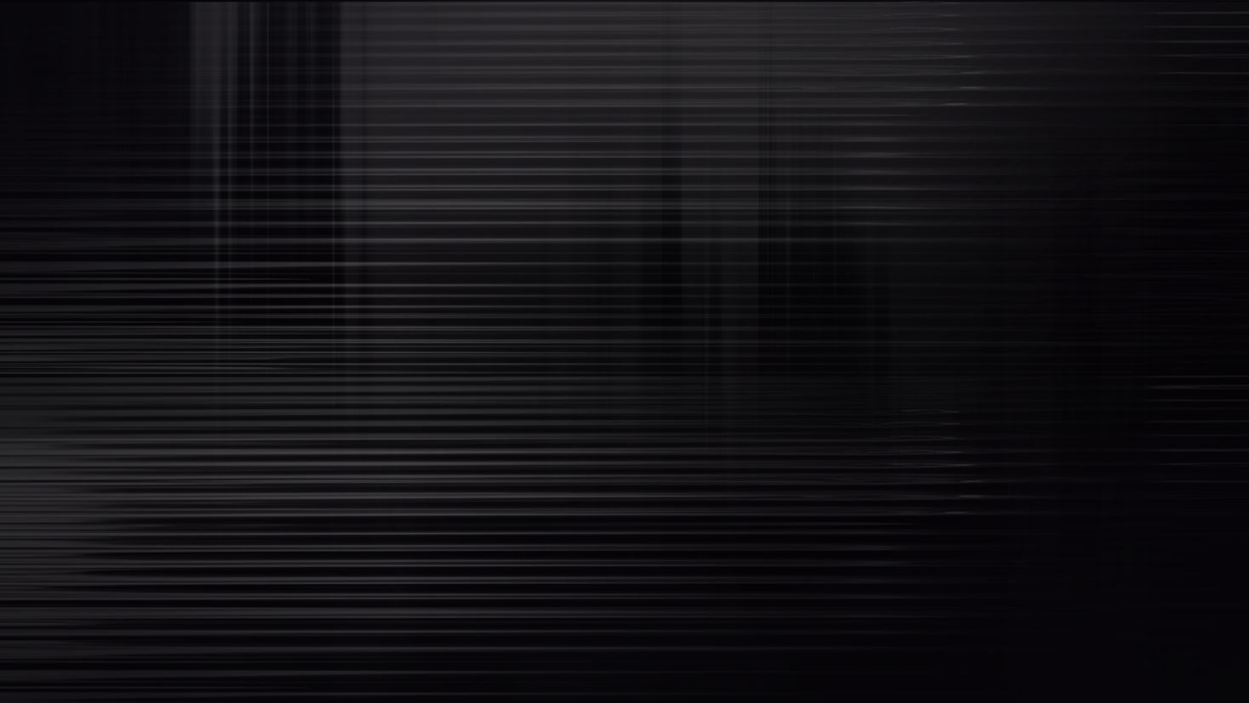
01
Why Formations Matter

Slide 4




01
Visual Impact
Dance formations guide the audience's focus, creating a visual narrative that enhances the choreography. By strategically placing dancers, formations can highlight key moments and create a cohesive performance.
Formations Shape the Story
Hiding Weaknesses
02
Clever formations can mask imperfections in a performance. By positioning dancers in a way that emphasizes strengths and minimizes weaknesses, the overall performance appears more polished and professional.
Solo Moments
03
Formations allow for seamless transitions between group and solo performances. By creating clear pathways and focal points, formations ensure that solo moments shine without disrupting the flow of the dance.

Slide 5


Three Rules Before You Place
01
Anchor Point
02
Clear Sight-lines
Always establish a central anchor point in your formation. This provides a stable reference for the audience and helps maintain a clear visual hierarchy throughout the performance.
Ensure that all dancers have clear sight-lines to the audience. This prevents blocking and ensures that every dancer's movements are visible, enhancing the overall impact of the performance.

Slide 6
02
Classic Linear Shapes

Slide 7


Straight Line vs Staggered Line
01
02
03
04
Straight Line
Staggered Line
Sight-line Clarity
Versatility
A straight line formation creates a powerful visual impact, perfect for synchronized movements. It emphasizes uniformity and precision, making it ideal for high-energy routines.
Staggered lines offset dancers slightly, providing a dynamic and visually interesting alternative to the straight line. This formation ensures that all dancers are visible and adds depth to the performance.
In a staggered line, each dancer has a clear sight-line, preventing any blocking. This formation is particularly useful for routines that require individual expressions within a group setting.
Both straight and staggered lines can be easily modified to suit different choreographic needs, making them versatile choices for any dance performance.

Slide 8


Diagonal Power
Dynamic Movement
Diagonal lines create a sense of movement and direction, drawing the audience's eye across the stage. This formation is ideal for routines that involve traveling steps or transitions.
Forced Perspective
By angling the line from one corner of the stage to the opposite, diagonal formations can create a forced perspective effect, making the group appear larger and more dynamic.

Slide 9


V and Inverted V
03
02
Versatility
01
Both V and inverted V formations can be easily transitioned into other shapes, making them versatile choices for dynamic choreography.
Inverted V
V Formation
The inverted V formation creates a sense of expansion, with dancers fanning out from a central point. This formation is ideal for moments of high energy and can be used to fill the stage effectively.
The V formation focuses attention on the front dancer, making it perfect for highlighting a soloist or a key moment in the choreography. It creates a natural focal point and adds a sense of depth to the stage.

Slide 10
03
Geometric Power Zones

Slide 11

The Almighty Triangle
Symmetry and Balance
01
The triangle formation provides perfect symmetry and balance, making it a visually appealing choice for any dance routine. It ensures that all dancers are visible and creates a sense of unity.
Scalability
02
Triangles can be easily scaled up or down, allowing for flexibility in group size. This formation works well for both small and large groups, maintaining its visual impact.

Slide 12

Diamond and X Dynamics
02
01
03
X Formation
Diamond Formation
Versatility
The X formation adds a dynamic twist to the diamond, with dancers positioned at the tips and center. This formation creates a sense of movement and can be used to highlight transitions.
The diamond formation places dancers at the four cardinal points, creating a balanced and visually striking shape. It is ideal for routines that require clear focal points and synchronized movements.
Both diamond and X formations can be easily modified to suit different choreographic needs, making them versatile choices for any performance.

Slide 13


Circles and Spirals
01
02
Circular Formation
Spiral Formation
A full circle formation wraps the audience in a 360-degree experience, making it perfect for moments of unity and connection. It is ideal for routines that involve group interactions.
The spiral formation adds a dynamic element to the circle, with dancers moving in or out in a spiral pattern. This formation creates a sense of flow and can be used to highlight transitions.

Slide 14
04
Odd-Number Hacks

Slide 15



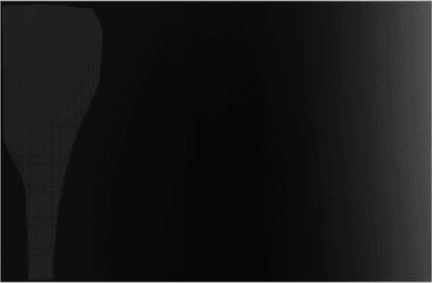

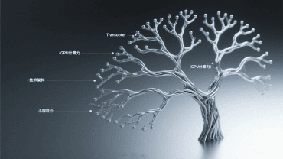
Making 5, 7, 9 Look Planned
01
Triangles Within Groups
03
For larger odd numbers like seven or nine, arrange dancers in nested triangles. This creates a sense of symmetry and balance, making the formation visually appealing.
Odd Numbers in Groups
Flexibility
Odd numbers can be visually appealing when arranged in groups. For example, a group of five can be arranged in a W shape, creating a balanced and dynamic formation.
Odd-number formations can be easily modified to suit different choreographic needs, making them versatile choices for any performance.
02

Slide 16


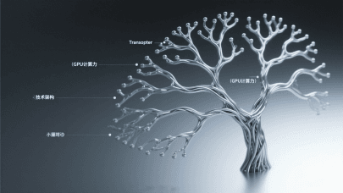
Prime-Number Pyramids
Pyramid Formation
For prime numbers like eleven or thirteen, a pyramid formation works well. Arrange dancers in layers, with one in the front row, two in the second, and so on. This creates a visually striking shape.
Density and Impact
The pyramid formation adds density to the stage, making the performance appear more dynamic and impactful. It is ideal for routines that require a strong visual presence.

Slide 17
05
Transitions & Flow

Slide 18





Silent Count Pathways
Mapping Movements
Map every transition on a grid to ensure smooth movement. Rehearse transitions at half speed to avoid collisions and maintain flow. This ensures a seamless performance.
01
02
Adding Music
Once transitions are smooth, add music to synchronize movements. This creates a cohesive performance that flows naturally from one formation to the next.
02

Slide 19

Texture Tricks with Levels
02
01
03
3D Sculptures
Level changes transform static formations into 3D sculptures. This adds a dynamic element to the performance, enhancing its visual impact.
Level Changes
Visibility
Incorporate level changes by having dancers kneel, crouch, or leap. This adds texture and depth to the performance, making it more visually interesting.
Ensure that level changes are visible from all angles. This creates a cohesive performance that engages the audience from every seat.

Slide 20

Thank you.
Kimi AI
2025/08/05

